Slide 1


PERSISTENT
VOLUME
PV, PVC & STORAGE CLASS
KUBERNETES BASIC - VIETTQ

Slide 2
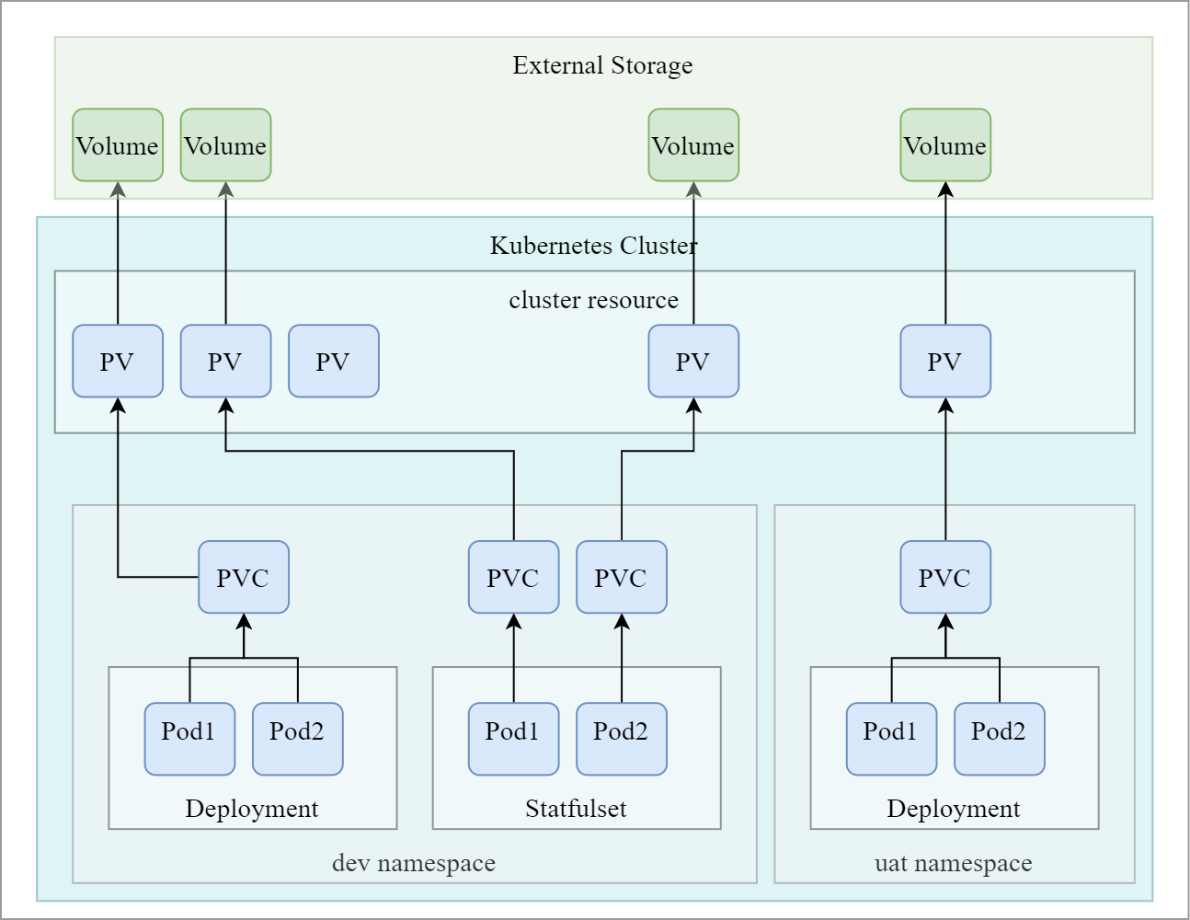
Kubernetes Storage
KUBERNETES BASIC - VIETTQ

Slide 3
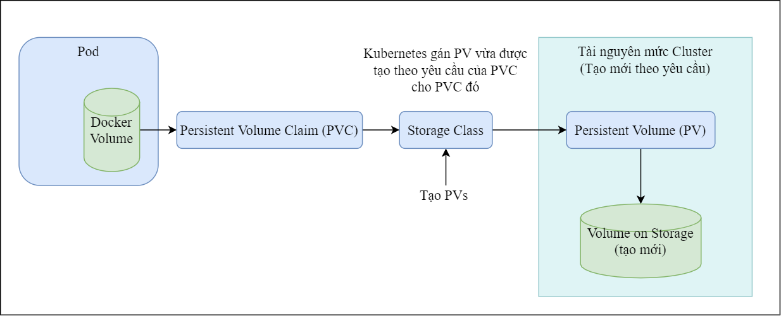
Kubernetes Storage
KUBERNETES BASIC - VIETTQ

Slide 4
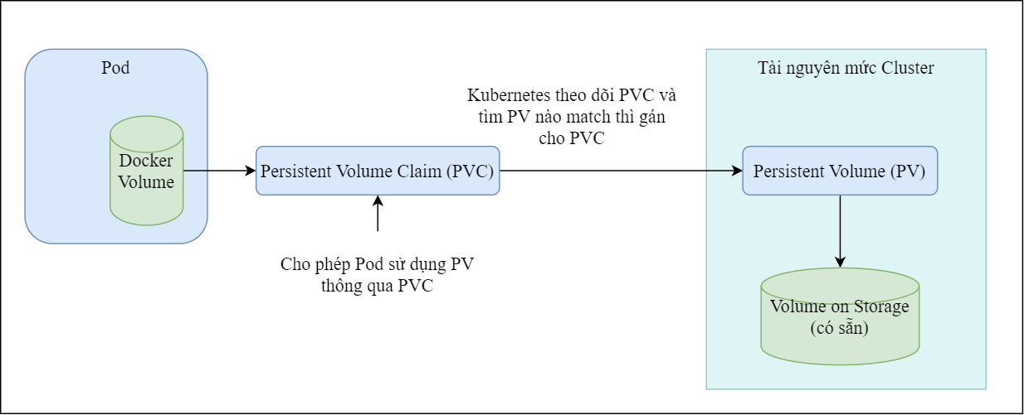
Kubernetes Storage
KUBERNETES BASIC - VIETTQ

Slide 5
PERSISTENT
VOLUME
PV, PVC & STORAGE CLASS
KUBERNETES BASIC - VIETTQ

